Slide 1

Travel raport
Henni Styf
Animal attendant
1.11.2024-10.1.2023
Sweden sjöbo
Stall Petra Aittola
Borelundsvägen, 7, 24745 Torna hällestad

Slide 2
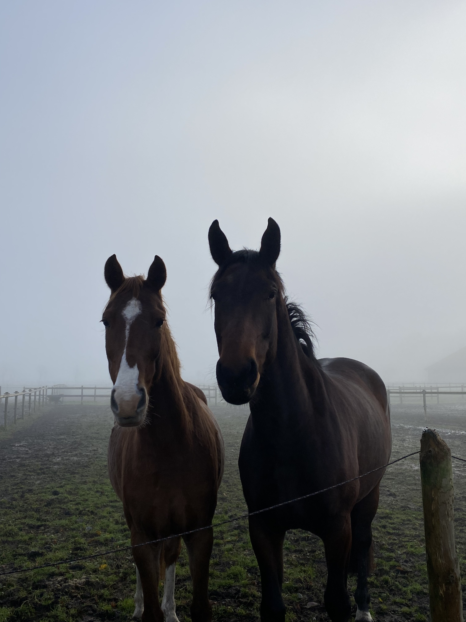
I applied to the exchange program because when I started school, I wanted to learn at work place, rather than at school.
I heard about the exchange program from my teacher because her daughter is an exchange student in Germany. And my teacher told me it was possible to be a working student abroad.
My preparing for going abroad was good I got lots of support and information and being abroad was everything I hoped for.
The coaching that Keuda gave me was really important and I felt really good leaving abroad because of all the information that I got.
And the only thing that I think the coaching was lacking is that I didn't prepare you to the fact you are going to make good friend and you have to say goodbye to them eventually.

Slide 3
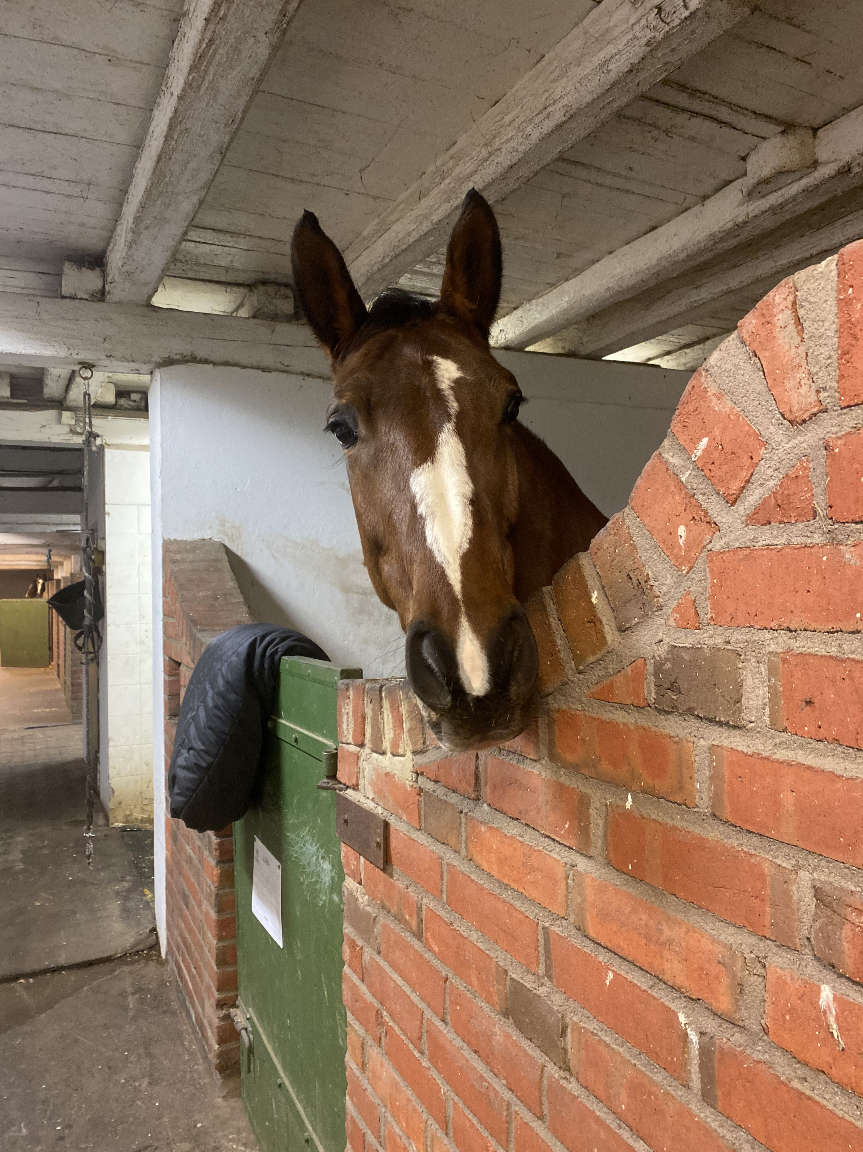
My work place was really nice and I got work with so many amazing people. My work was crazy close where I lived so I got lots of free time too
My day would start at 7 in the morning we take the horses out and muck out, do the hays and other morning chores. I would go to lunch between 11-12 for a hour. After lunch I would help tack up the horses and do other stuff really depends on the day.
Working with horses is more professional but otherwise pretty similar than in finland.

Slide 4
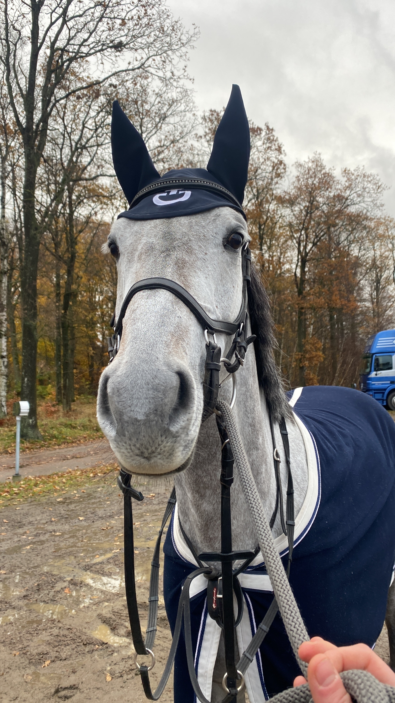
The troubles I faced in Sweden were not big because I was prepared but sometimes, I had trouble with finding where I was supposed go when using google maps because it doesn't show all of, the roads but got through, them by asking for help.
If you go to Sweden, you should be careful with trusting everyone because Swedish people are really nice even, when they might not like you that much.
Next time I go abroad I would not stress as much because at the end of the day everything will be okay
I would but money aside for more fun things
In Sweden I didn't like so much that people were too nice and sweet then really don't like you
In Sweden I love my real friends and how they made me feel so loved

Slide 5
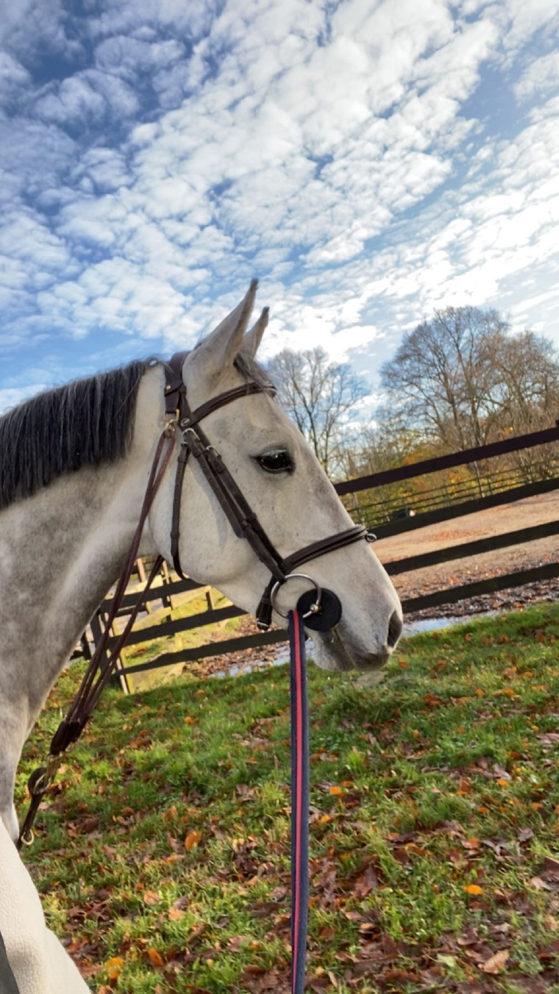
The one better thing is that Finnish people are more honest and say things how they are. In Finland also people mind they own business more.
In Sweden people are helpful and willing to a lot for you and make you feel really good. Swedish culture is really comforting and loving.
To be more helpful to strangers
I learned to be more open and listen to what people have to say to me. I've learned that even when sometimes things are hard, you'll get trough, them when you have the right people beside you
I got to learn more about how to care more about better horses and how we support their best growth.
The time abroad made me more kind and made me realize I need to love myself because if I don't love myself, I can't love anyone else.

Slide 6
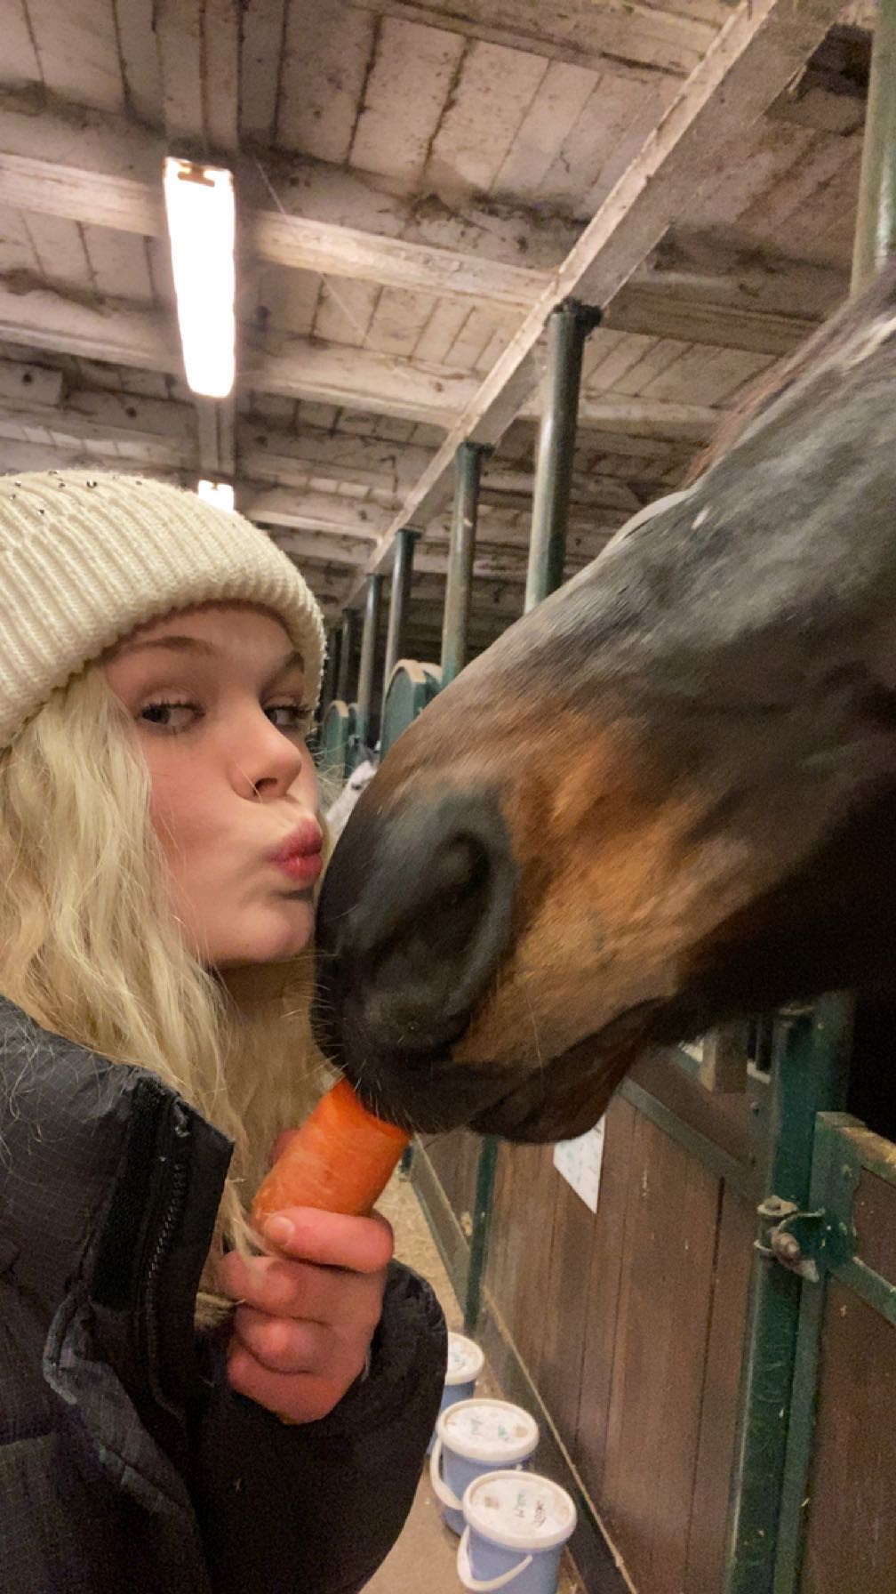
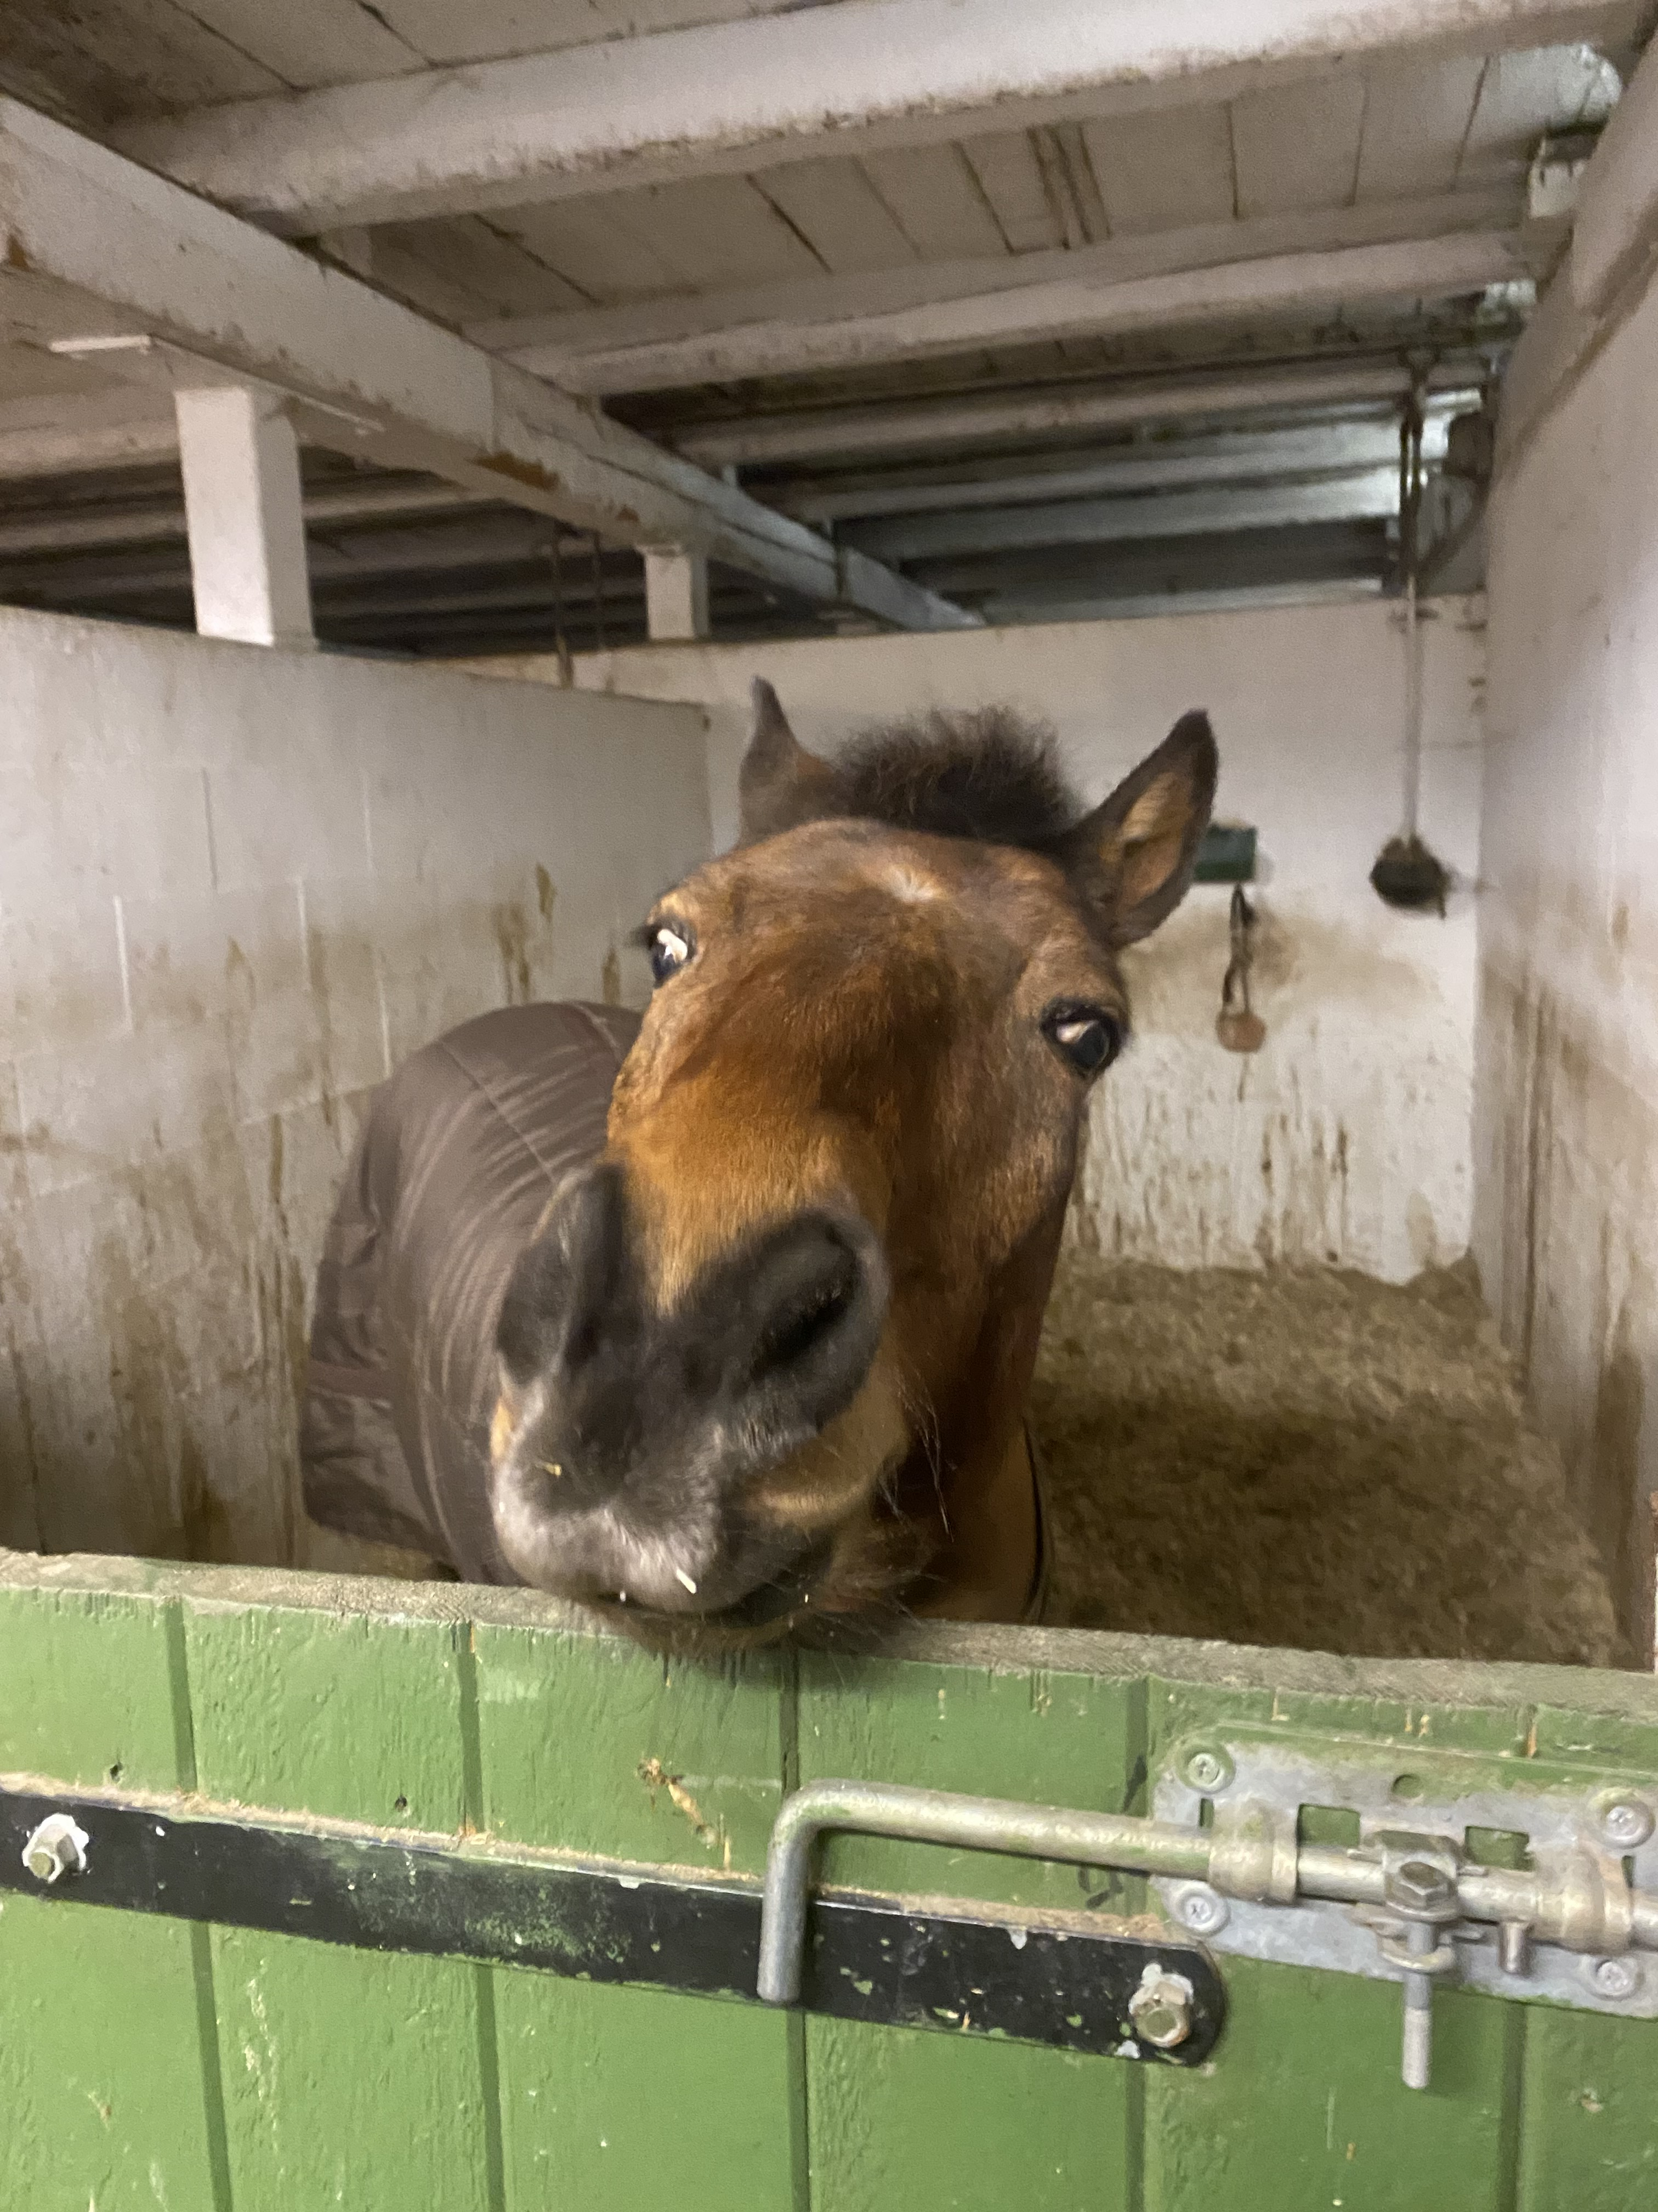
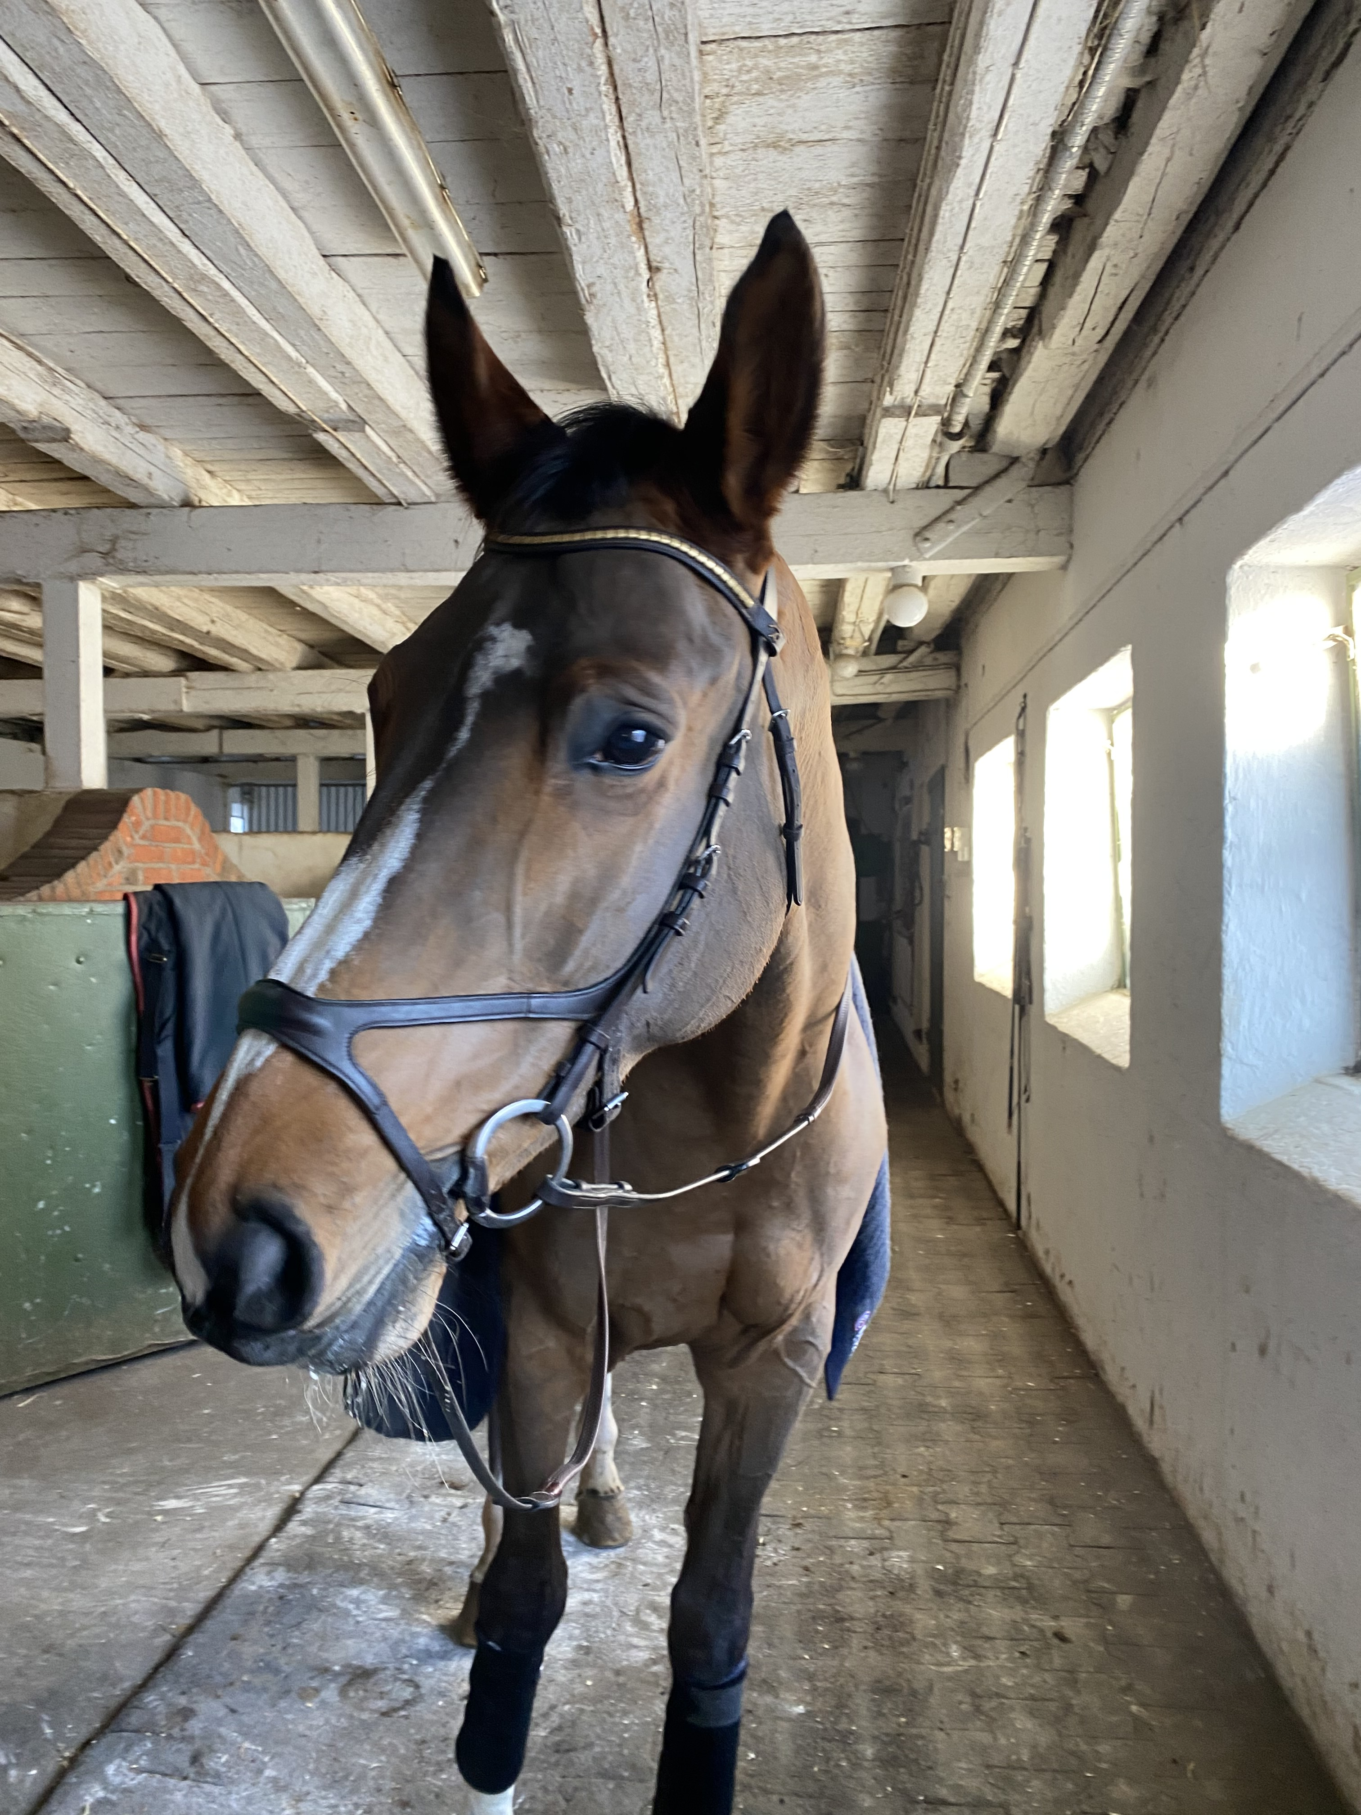
In my free time I ate with my friends and hangout with them and we went to the movies ect. I met a lot of lovely people the kind you can talk for hours with the time just flying by.
Everyday life was nice I would go to work after work I would go to the store maybe usually with friends and on my days of I liked to clean so I could enjoy the clean surroundings.
The accommodation I was is I got through, my boss and I lived with 4 roommates. And living is pretty same than in Finland.
Routines help a lot with everyday life and for example when you are missing home. And also, being careful with going out alone when you don't know the area.

Slide 7
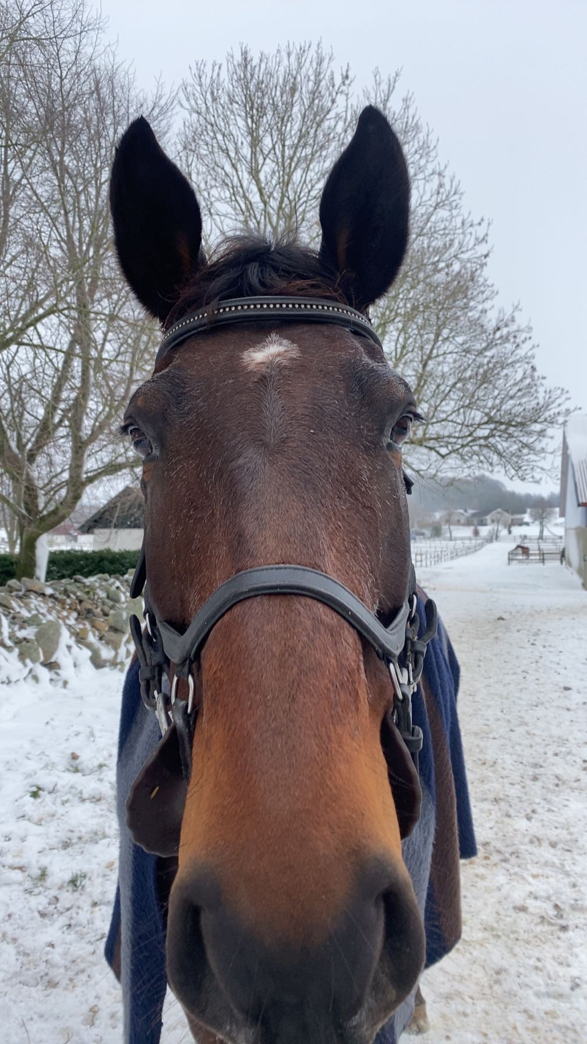
I prepared for leaving by checking that I had all needed documents and looked the weather to check what kind of clothes I would need to buy.
I didn't fly to Sweden I actually went on the ferry and the train. And I used the internet to my advantage to see what is the best way to travel there.
So, I am actually staying here but the way here I was really nervous and stressed a lot because I wasn't sure what to expect but otherwise traveling here went good.
So the covid situation is good here because it's 2024 and covid has been calmer.

Slide 8
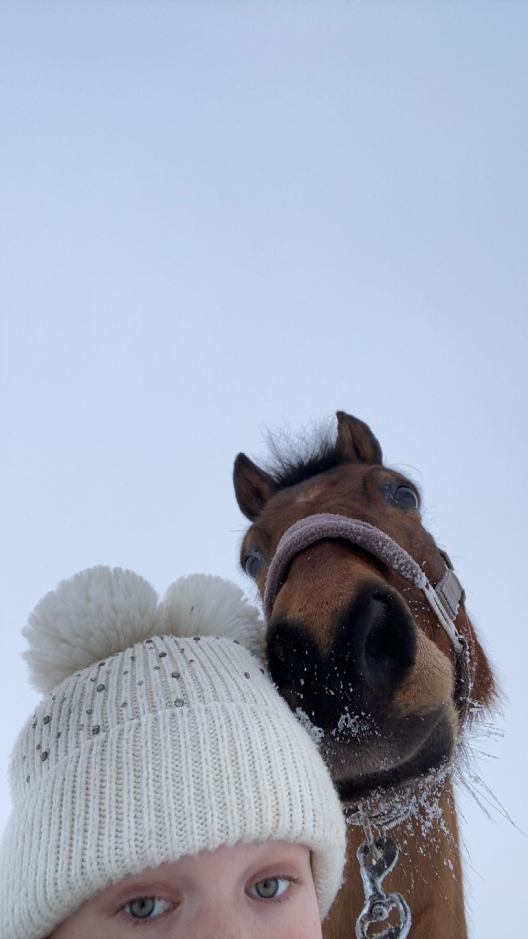
If you are thinking going abroad, do it if you have the chance go for it you are not going lose anything by doing so. It is a really good experience and I promise you are going to have so much fun.
It is okay to be scared and terrified but at the of the day every is going to fine

